Slide 1


DATA STRUCTURES AND ALGORITHMS
Binary Tree
CCE 105
Data Structures
Prepared by:

Slide 2


Topics
Trees
Binary Tree
Binary Search Tree

Slide 3

01
Trees

Slide 4

So far we have seen linear structures • linear: before and after relationship • lists, vectors, arrays, stacks, queues, etc Non-linear structure: trees • probably the most fundamental structure in computing • hierarchical structure • Terminology: from family trees (genealogy)
Trees

Slide 5
A tree consists of nodes connected by edges. store elements hierarchically the top element: root except the root, each element has a parent each element has 0 or more children
Trees

Slide 6
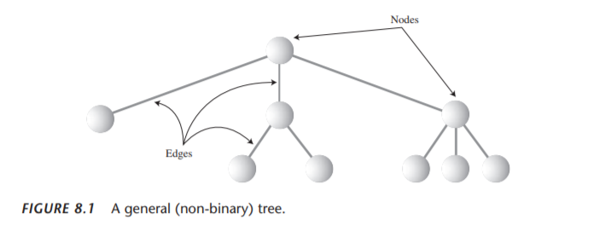
Trees

Slide 7
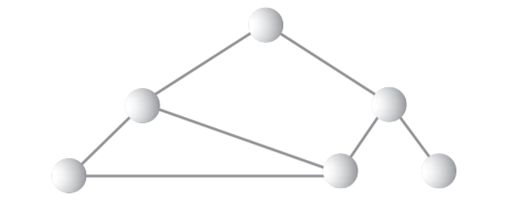
Is this a Tree?

Slide 8
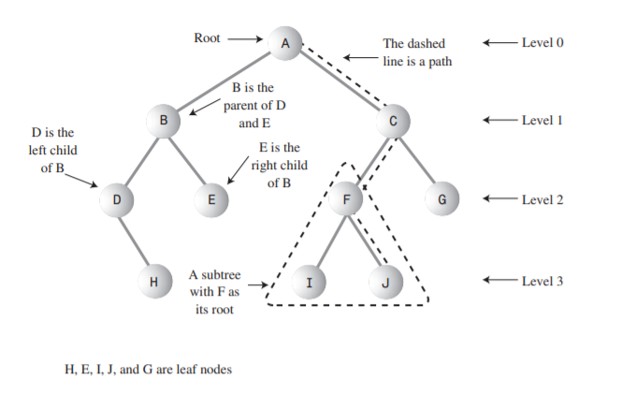
Tree Terminology

Slide 9
Tree Terminology
Path
Root
Think of someone walking from node to node along the edges that connect them. The resulting sequence of nodes is called a path.
The node at the top of the tree is called the root. There is only one root in a tree. For a collection of nodes and edges to be defined as a tree, there must be one (and only one!) path from the root to any other node.

Slide 10
Tree Terminology
Parent
Leaf
Any node (except the root) has exactly one edge running upward to another node. The node above it is called the parent of the node.
A node that has no children is called a leaf node or simply a leaf. There can be only one root in a tree, but there can be many leaves.
Child
Subtree
Any node may have one or more lines running downward to other nodes. These nodes below a given node are called its children.
Any node may be considered to be the root of a subtree, which consists of its children, and its children’s children, and so on. If you think in terms of families, a node’s subtree contains all its descendants.

Slide 11
Tree Terminology
Visiting
Levels
A node is visited when program control arrives at the node, usually for the purpose of carrying out some operation on the node, such as checking the value of one of its data fields or displaying it. Merely passing over a node on the path from one node to another is not considered to be visiting the node.
The level of a particular node refers to how many generations the node is from theroot. If we assume the root is Level 0, then its children will be Level 1, its grandchildren will be Level 2, and so on.
Keys
We’ve seen that one data field in an object is usually designated a key value. This value is used to search for the item or perform other operations on it. In tree diagrams, when a circle represents a node holding a data item, the key value of the item is typically shown in the circle.
Traversing
To traverse a tree means to visit all the nodes in some specified order. For example, you might visit all the nodes in order of ascending key value. There are other ways to traverse a tree, as we’ll see later.

Slide 12
02
Binary Trees

Slide 13
It combines the advantages of two other structures: an ordered array and a linked list. You can search a tree quickly, as you can an ordered array, and you can also insert and delete items quickly, as you can with a linked list. If every node in a tree can have at most two children, the tree is called a binary tree. The two children of each node in a binary tree are called the left child and the right child, corresponding to their positions when you draw a picture of a tree. A node in a binary tree doesn’t necessarily have the maximum of two children; it may have only a left child, or only a right child, or it can have no children at all (in which case it’s a leaf).
Why Use Binary Trees?

Slide 14

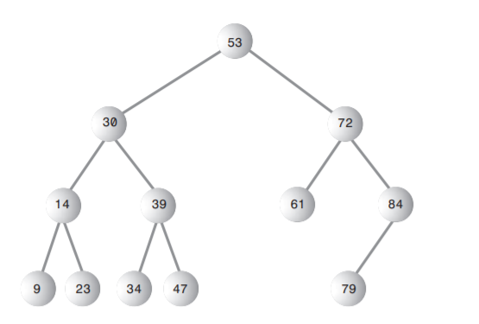
A Binary Tree
Based on the Binary Tree on the left, identify the following:
1. Root
2. Leaf
3. Subtree
4. Levels

Slide 15
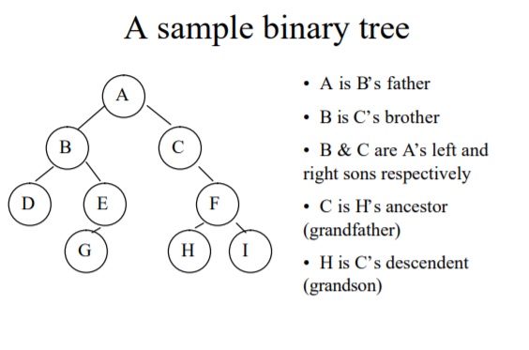
Binary Tree Sample

Slide 16
03
Binary Search Trees

Slide 17
Common binary tree operations: finding a node with a given key inserting a new node traversing the tree deleting a node
How Do Binary Search Trees Work?

Slide 18
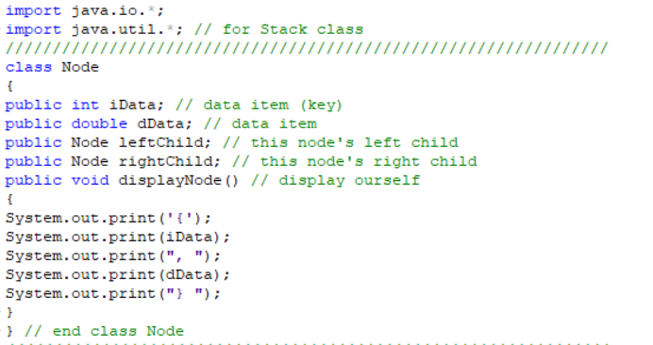

Binary Search Tree Sample Program

Slide 19
Inserting a Node
Input: { 40, 4, 34, 45, 14, 55, 48, 13, 15, 49, 47 }
Input: 47
Input: 13
Input: 48
Input: 55
Input: 49
Input: 15
Input: 34
Input: 4
Input: 14
Input: 45
Input: 40
40
4
45
34
55
14
48
13
15
47
49

Slide 20
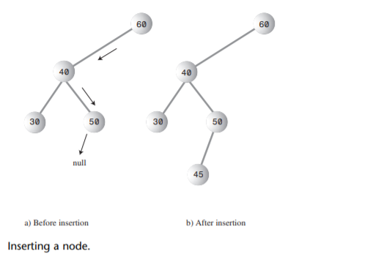
Inserting a Node
Let us try to insert 45

Slide 21
Let us create a Binary Tree!
Input: { 63, 80, 70, 27, 92, 13, 51, 26, 58, 33, 60, 57, 82}
Get your pen
and paper
63
27
80
13
51
70
92
26
33
58
82
57
60

Slide 22
Let us create a Binary Tree!
Insert: 30, 95, 86, 9
Get your pen
and paper
63
27
80
13
51
70
92
9
26
33
58
82
95
30
57
60
86

Slide 23
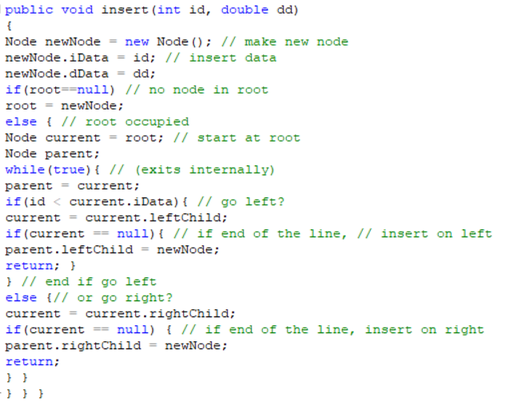
Binary Search Tree Sample Program
Inserting a Node

Slide 24
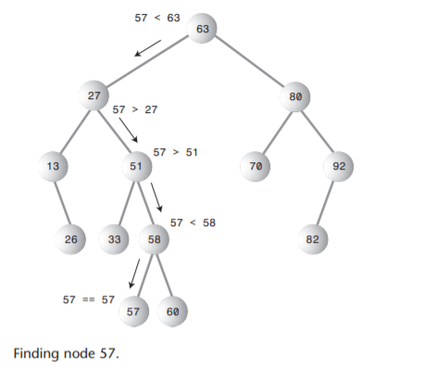
Finding a node with a given key

Slide 25
Finding a node with a given key
Let’s try to search Node 27

Slide 26
Finding a node with a given key
Let’s try to search Node 14

Slide 27
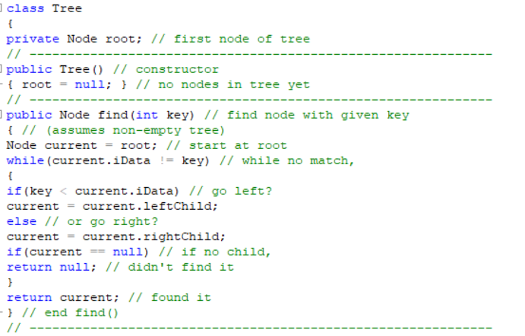
Binary Search Tree Sample Program
Finding a node with a given key

Slide 28
Traversing a tree means visiting each node in a specified order. There are three simple ways to traverse a tree. They're called preorder, inorder, and postorder.
Traversing the Tree

Slide 29
Inorder Traversal An inorder traversal of a binary search tree will cause all the nodes to be visited in ascending order, based on their key values. If you want to create a sorted list of the data in a binary tree, this is one way to do it.
Traversing the Tree

Slide 30
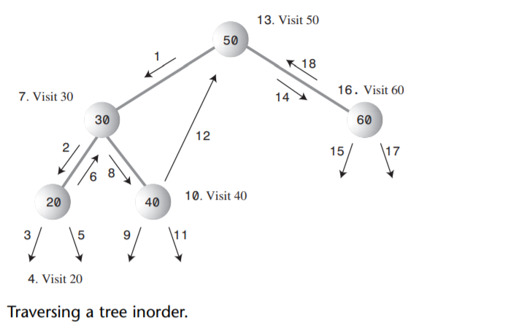
Traversing the Tree Inorder Traversal
1. Call itself to traverse the node’s left subtree.
2. Visit the node.
3. Call itself to traverse the node’s right subtree

Slide 31
Traversing the Tree: Inorder Traversal
1. Call itself to traverse the node’s left subtree.
2. Visit the node.
3. Call itself to traverse the node’s right subtree
Input: { 40, 4, 34, 45, 14, 55, 48, 13, 15, 49, 47 }
Input: 47
Input: 13
Input: 48
Input: 55
Input: 49
Input: 15
Input: 34
Input: 4
Input: 14
Input: 45
Input: 40
40
20. Visit 40
1
40
19
4
21
45
2
39
3. Visit 4
4
22
23. Visit 45
37. Visit 55
34
24
55
5
17. Visit 34
25
16
38
14
18
48
36
11. Visit 14
6
26
31. Visit 48
10
12
30
15
32
13
47
49
7
8. Visit 13
13
14. Visit 15
27
28. Visit 47
33
34. Visit 49
9
15
29
35
Output:
4, 13, 14, 15, 34, 40, 45, 47, 48, 49, 55

Slide 32
Traversing the Tree Inorder Traversal
Input:
40, 4, 34, 45, 14, 55, 48, 13, 15, 49, 47
20. Visit 40
1
40
19
21
23. Visit 45
2
39
1. Call itself to traverse the node’s left subtree.
2. Visit the node.
3. Call itself to traverse the node’s right subtree
3. Visit 4
4
22
24
17. Visit 34
37. Visit 55
5
25
16
18
36
38
11. Visit 14
31. Visit 48
6
26
10
12
30
32
7
9
13
15
27
29
33
35
8. Visit 13
14. Visit 15
28. Visit 47
34. Visit 49
Output:
4, 13, 14, 15, 34, 40, 45, 47, 48, 49, 55

Slide 33
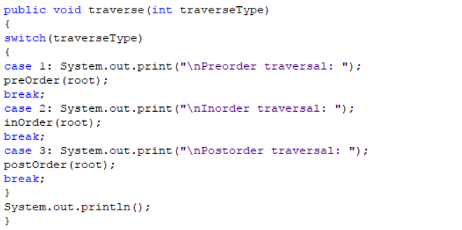
Binary Search Tree Sample Program
Traversing the Tree: Inorder traversal

Slide 34
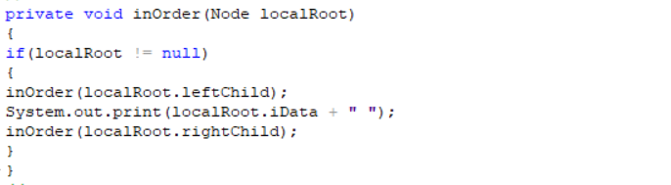
Binary Search Tree Sample Program
Traversing the Tree: Inorder traversal

Slide 35
Traversing the Tree Preorder Traversal
Input:
40, 4, 34, 45, 14, 55, 48, 13, 15, 49, 47
1. Visit 40
2
40
3. Visit 4
20
22. Visit 45
1. Visit the node.
2. Call itself to traverse the node’s left subtree.
3. Call itself to traverse the node’s right subtree.
39
4
5
23
6. Visit 34
24
25. Visit 55
7
26
18
19
37
8. Visit 14
27. Visit 48
38
9
14
28
13
32
10. Visit 13
33
15. Visit 15
34. Visit 49
11
12
16
17
30
29. Visit 47
31
35
36
Output:
40, 4, 34, 14, 13, 15, 45, 55, 48, 47, 49

Slide 36
Traversing the Tree: Preorder Traversal
1. Visit the node.
2. Call itself to traverse the node’s left subtree.
3. Call itself to traverse the node’s right subtree.
Input: { 40, 4, 34, 45, 14, 55, 48, 13, 15, 49, 47 }
1. Visit 40
Input: 47
Input: 13
Input: 48
Input: 55
Input: 49
Input: 15
Input: 34
Input: 4
Input: 14
Input: 45
Input: 40
40
2
40
20
4
21
45
4
39
3. Visit 4
5
23
22. Visit 45
25. Visit 55
34
24
55
7
6. Visit 34
26
18
38
14
19
48
37
8. Visit 14
9
28
27. Visit 48
13
14
32
33
13
15
47
49
11
10. Visit 13
16
15. Visit 15
30
29. Visit 47
35
34. Visit 49
12
17
31
36
Output:
40, 4, 34, 14, 13, 15, 45, 55, 48, 47, 49

Slide 37
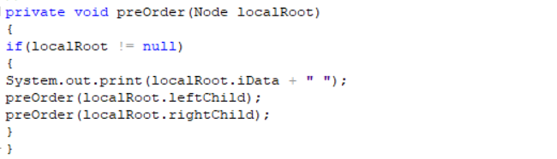
Traversing the Tree Preorder Traversal
Input:
40, 4, 34, 45, 14, 55, 48, 13, 15, 49, 47
Output:
40, 4, 34, 14, 13, 15, 45, 55, 48, 47, 49
1. Visit the node.
2. Call itself to traverse the node’s left subtree.
3. Call itself to traverse the node’s right subtree.

Slide 38
Traversing the Tree Postorder Traversal
Input:
40, 4, 34, 45, 14, 55, 48, 13, 15, 49, 47
43. Visit 40
42
1
1. Call itself to traverse the node’s left subtree.
2. Call itself to traverse the node’s right subtree.
3. Visit the node.
20. Visit 4
21
41. Visit 45
19
22
40
2
23
3
18. Visit 34
24
39. Visit 55
4
25
16
17
37
38
15. Visit 14
36. Visit 48
5
14
26
35
9
10
30
31
34. Visit 49
6
8. Visit 13
7
11
12
27
28
32
33
13. Visit 15
29. Visit 47
Output:
13, 15, 14, 34, 4, 47, 49, 48, 55, 45, 40

Slide 39
Traversing the Tree: Postrder Traversal
1. Call itself to traverse the node’s left subtree.
2. Call itself to traverse the node’s right subtree.
3. Visit the node.
Input: { 40, 4, 34, 45, 14, 55, 48, 13, 15, 49, 47 }
Input: 47
Input: 13
Input: 48
Input: 55
Input: 49
Input: 15
Input: 34
Input: 4
Input: 14
Input: 45
Input: 40
40
43. Visit 40
1
42
21
22
45
41. Visit 45
4
19
40
2
39. Visit 55
20. Visit 4
3
34
23
24
55
4
18. Visit 34
25
16
37
38
14
17
48
15. Visit 14
36. Visit 48
5
14
26
35
9
10
30
15
31
13
47
49
6
11
13. Visit 15
27
32
34. Visit 49
7
12
29. Visit 47
33
8. Visit 13
28
Output:
13, 15, 14, 34, 4, 47, 49, 48, 55, 45, 40

Slide 40
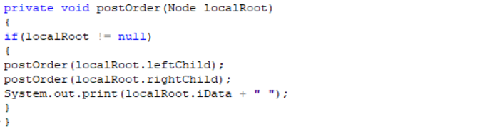
Traversing the Tree Postorder Traversal
Input:
40, 4, 34, 45, 14, 55, 48, 13, 15, 49, 47
Output:
13, 15, 14, 34, 4, 47, 49, 48, 55, 45, 40
1. Call itself to traverse the node’s left subtree.
2. Call itself to traverse the node’s right subtree.
3. Visit the node.

Slide 41
Let us test your learning!
1. Suppose you have the following items to be inserted in your tree.
58, 45, 92, 35, 81, 50, 95, 22,
48, 54, 37, 85, 90, 78, 71
a. Create a binary tree using the items above.
b. Identify the following:
• Levels(), subtree/s and leaf
c. Do the inorder, preorder and postorder traversing method. (Show your solution)
Use your pen and paper in answering this quiz. Capture your answer using your camera and submit in the Google Classroom. Make sure that your handwritten is readable and the captured image is not pixelated.

